Slide 1

A project report
On
Housing – Price Prediction

Slide 2
SUBMITTED BY
HIMAJA IJJADA
Caution - Please view the presentation as a slide show for better experience

Slide 3
TOPICS TO BE DISCUSSED
Introduction
Problem statement
Conceptual Background of the Domain Problem
Motivation for the Problem Undertaken
Mathematical/ Analytical Modeling of the Problem
Data Sources and their formats
Data Preprocessing Done
Visualizations
Model/s Development and evaluation
Key Findings and Conclusions of the Study

Slide 4
Introduction
Houses are one of the necessary needs of each and every person around the globe and therefore housing and real estate market is one of the major contributors in the world’s economy. It has a huge chunk of market and there are various companies working in this domain. Data science becomes a very important tool to solve problems in this field to help the companies increase their overall revenue, profits, improving their marketing strategies and focusing on changing trends in house sales and purchases. Predictive modelling, Market mix modelling, recommendation systems are some of the machine learning techniques used for achieving the business goals for housing companies.

Slide 5
Problem statement
A US-based housing company named Surprise Housing has decided to enter the Australian market. The company uses data analytics to purchase houses at a price below their actual values and flip them at a higher price. For the same purpose, the company has collected a data set from the sale of houses in Australia. The company is looking at prospective properties to buy houses to enter the market. You are required to build a model using Machine Learning in order to predict the actual value of the prospective properties and decide whether to invest in them or not. For this company wants to know:
Which variables are important to predict the price of variable?
How do these variables describe the price of the house?

Slide 6
Conceptual Background of the Domain Problem
Predictive modelling, Market mix modelling, recommendation systems are some of the machine learning techniques used for achieving the business goals for housing companies.
Hedonic Characteristics of Housing Price: A Hedonic approach is preferred for predicting the sale prices in the housing market because the market displays resilience, flexibility and spatial fixity.
Housing Attributes: Studying the structural, locational, and economic attributes of housing properties is crucial in understanding their mutually inclusive relationships with their pricing.

Slide 7
Motivation for the Problem Undertaken
There is a steady rise in house demand with every passing year, and consequently the house prices are rising every year. The problem arises when there are numerous variables such as location and property demand that influence the pricing.
Therefore, buyers, sellers, developers and the real estate industry are keen to know the most important factors influencing the house price to help investors make sound decisions and help house builders set the optimal house price.
There are many benefits that home buyers, property investors, and house builders can reap from the house-price model.

Slide 8
This model aims to serve as a repository of such information and gainful insights to home buyers, property investors and house builders that will help them determine best house prices.
This model can be useful for potential buyers in deciding the characteristics of a house they want that best fits their budget and will be of tremendous benefit, especially to housing developers and researchers, to ascertain the most significant attributes to determine house prices and to acknowledge the best machine learning model to be used to conduct a study in this field.

Slide 9
Mathematical/ Analytical Modeling of the Problem
Various Regression analysis techniques were used to build predictive models to understand the relationships that exist between Housing sales prices and various Housing property attributes.
The Regression analysis models were used to predict the Sale price value for changes in Housing property attributes.
Regression modelling techniques were used in this Problem since Sales Price data distribution is continuous in nature.
In order to forecast house price, predictive models such as ridge regression Model, Random Forest Regression model, Decision tree Regression Model, Support Vector Machine Regression model, Extreme Gradient Boost Regression were used to describe how the values of Sale Price depended on the independent variables of various Housing property attributes.

Slide 10
Data Analysis steps :
Import Libraries
Import Dataset
Data Pre Processing
Ordinal encoding
Visualization
Finding null values

Slide 11
Data Sources and their formats
The dataset was compiled by a US-based housing company named Surprise Housing.
The company has collected a data set from the sale of houses in Australia. The dataset was made available in .csv file format.
There are 2 datasets: One for training the predictive machine learning models and the second one to be used by the models for predicting the SalePrice (target variable).
Training Dataset contains 1168 entries and 81 variables, while Test Dataset contains 292 entries and 80 variables

Slide 12
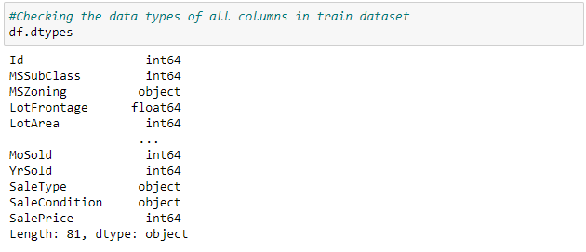
Data Preprocessing Done
Checking the data types of all columns in train dataset
Observations - In the train dataset we have int, object as well as flaot data types.

Slide 13
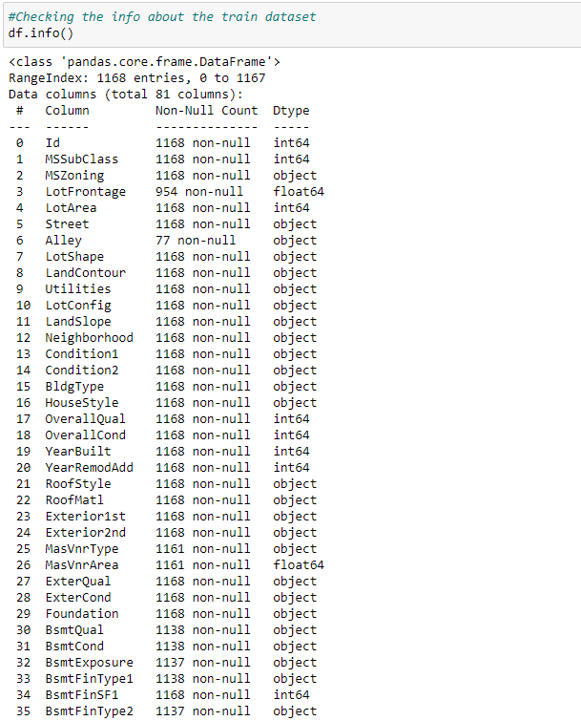
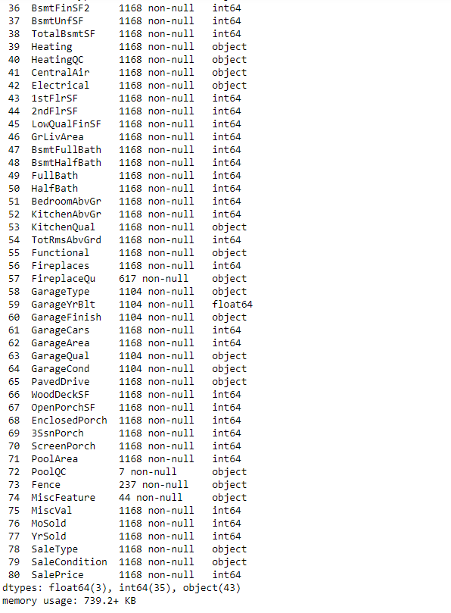
Checking the info about the train dataset
Observations
Above is the info about train dataset from which we can observe that
There are some missing values in the dataset, which needs to be filled using imputation techniques.
And in Alley, PoolQC, Fence and MiscFeature has more than 80% null values so we may drop these columns in the further steps

Slide 14
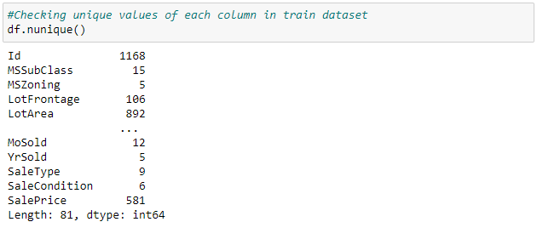
Checking unique values of each column in train dataset
Observations
In Id column the unique count is 1168 which means all the values in the column are unique and ID is the identity number given for particular asset so this ID has no purpose in developing a model and training. Hence it can be dropped.
In Utilities column unique value count is 1 which means all the entries are same this also has no purpose in model building so this column can also be dropped.

Slide 15
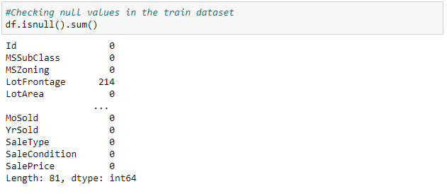
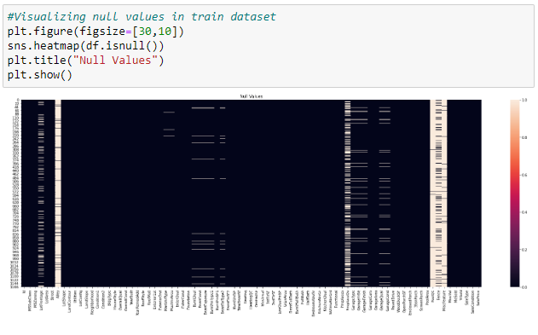
Checking null values in the train dataset
Visualizing null values in train dataset
Observations
Those columns with more than 50% (584 entries) null values can be dropped to avoid unnecessary issue for model development.
Those columns with less than 50% (584 entries) null values can be treated using imputation techniques.
The column FireplaceQu has 551 null values, which accounts to 50% approximately can also be dropped

Slide 16
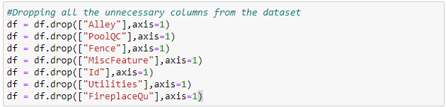
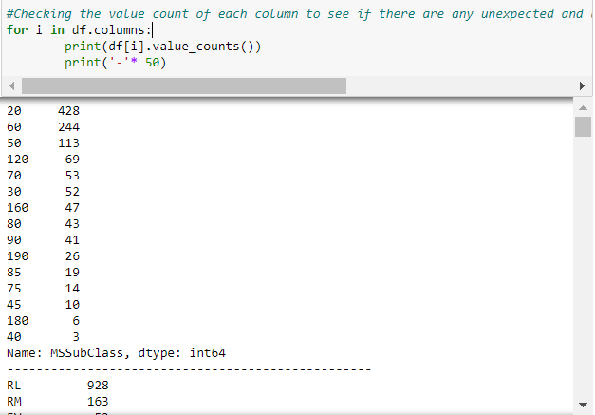
Dropping all the unnecessary columns from the dataset
Checking the value count of each column to see if there are any unexpected and unwanted entries present in the column in train dataset.
Observations
There are no unnecessary or duplicate entries in any column of the train dataset.
There are zero values as entries in some columns which are below 60%, hence they are acceptable and reasonable.
But there are 85% zero values as entries in the following columns
BsmtFinSF2
LowQualFinSF
EnclosedPorch
3SsnPorch
ScreenPorch
PoolArea
MiscVal
So lets drop these columns.

Slide 17
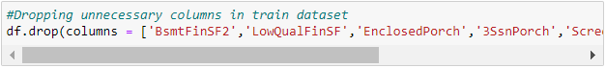
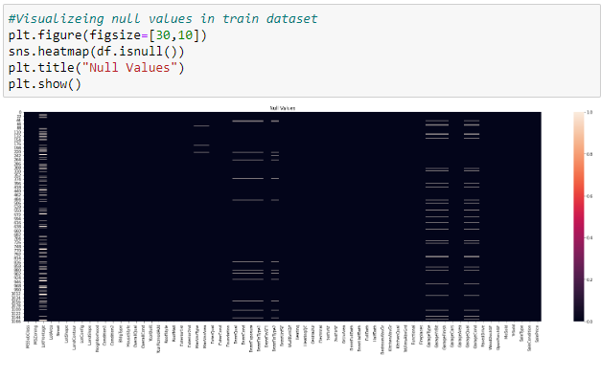
Dropping unnecessary columns in train dataset
Checking for null values in the train dataset again
Observations
We can observe that there are null values in most of the columns of the train dataset. We need to treat them using appropriate imputation techniques and fill them with their respective values.

Slide 18
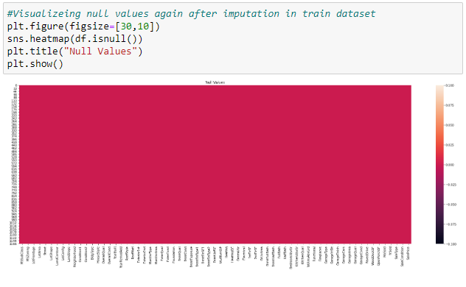
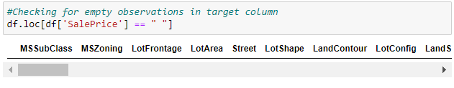
Created a list of categorical and numerical datatypes in train dataset
Replaced null values of categorical column with mode of that column in train dataset
Replaced null values of numerical column with mean of that column in train dataset.
Checking for null values again in train dataset
Checking for empty observations in target column
There are no empty observations in the target column of train dataset.

Slide 19
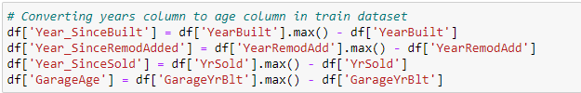
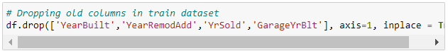
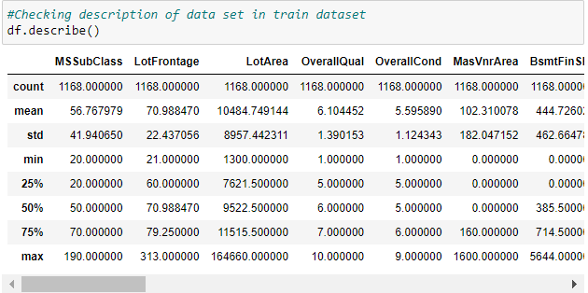
Converting years column to age column in train dataset
Dropping old columns in train dataset
We have converted all the year columns to their respective age, as age helps us more than year Built in the dataset.
Checking description of data set in train dataset
Big difference between max value and 75% in SalePrice, MSSubClass, LotFrontage, LotArea, BsmtFinSF1, BsmtF inSF2, etc. indicates presence of outliers.
A higher std than mean in columns:
- MasVnrArea
- BsmtFinSF1
- BsmtFinSF2
- WoodDeckSF
- OpenPorchSF, EnclosedPorch, 3SsnPorch etc. indicates presence of skewness.
An Anomaly is displayed in the relationship between age of house and SalePrice. There is a general negative relationship between House age and Sale Price, ie. Increase in age leads to a decrease in SalePrice. However, houses built between 1880 and 1900 sold for the highest. The assumption made in this regard is that those houses were sold for the highest amount because of their antiquity value.

Slide 20
Software Used:
Windows 10 Operating System
Anaconda Package and Environment Manager
Jupyter Notebook
Python3
Python Libraries used:
Pandas
Numpy
matplotlib, Seaborn
Scipy
Statsmodels
sklearn

Slide 21
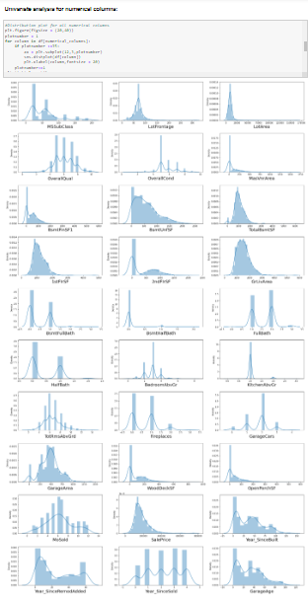
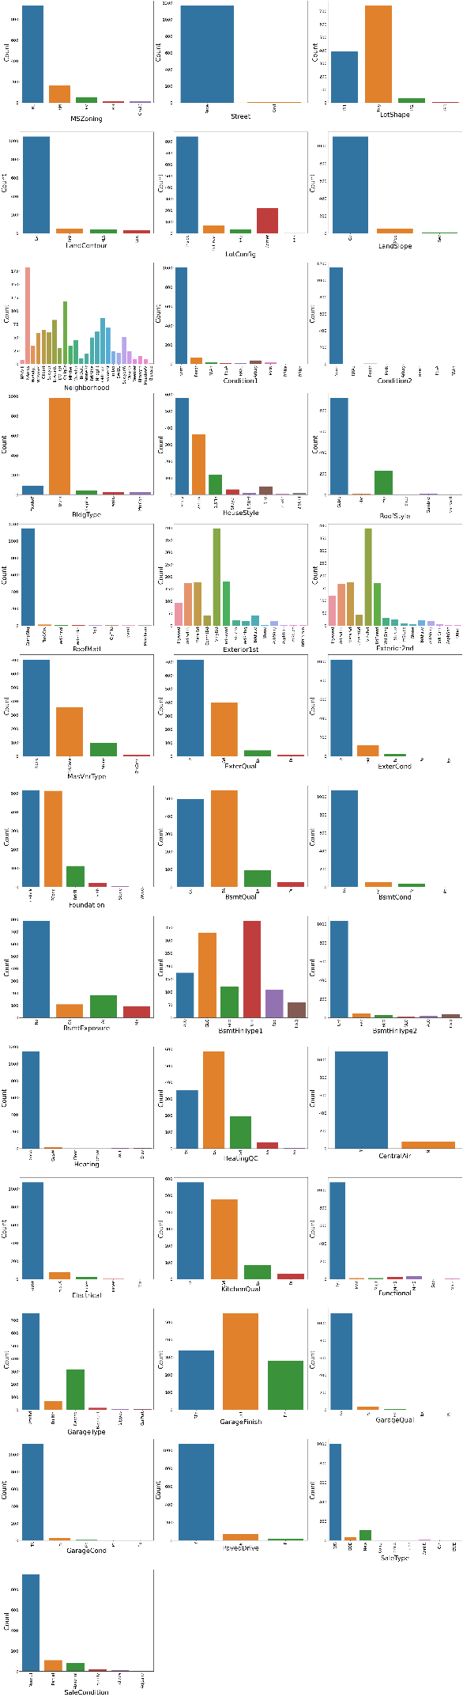
Visualizations – Univariate analysis

Slide 22
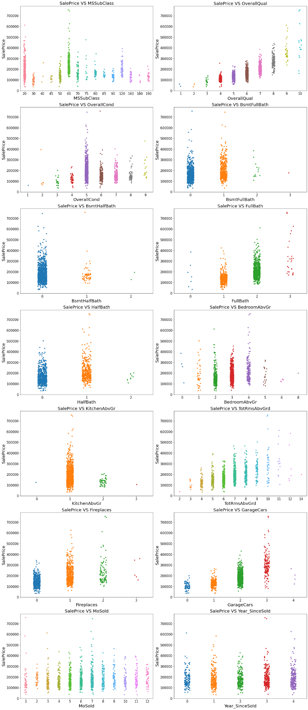
Plotting strip plot for the numerical columns

Slide 23
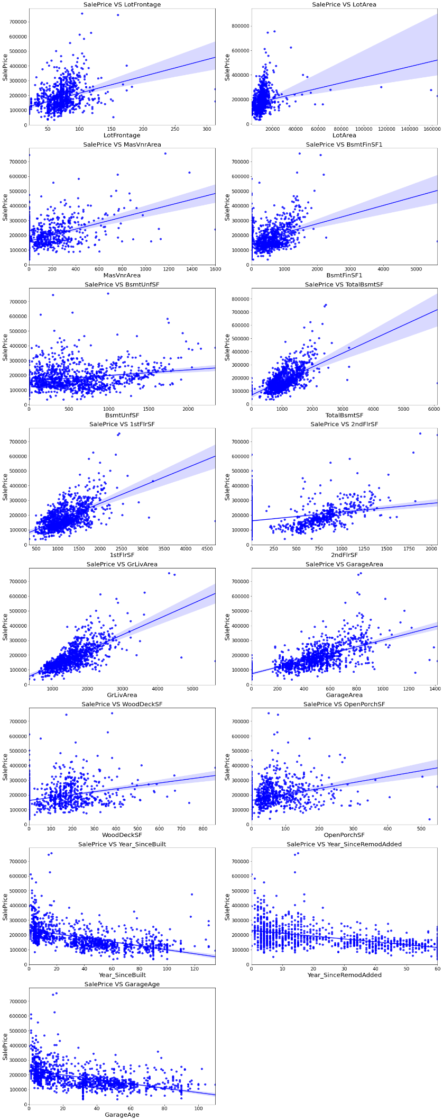
Bivariate analysis

Slide 24
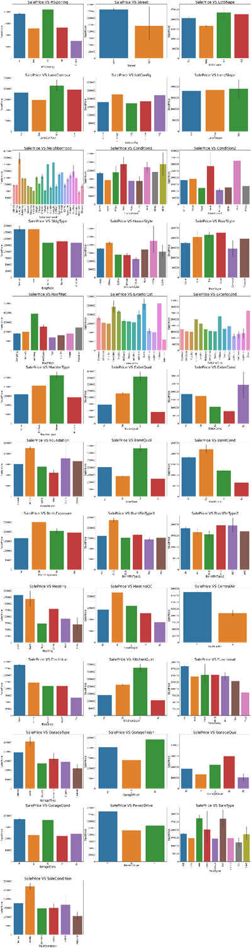
Bivariate analysis for categorical columns

Slide 25
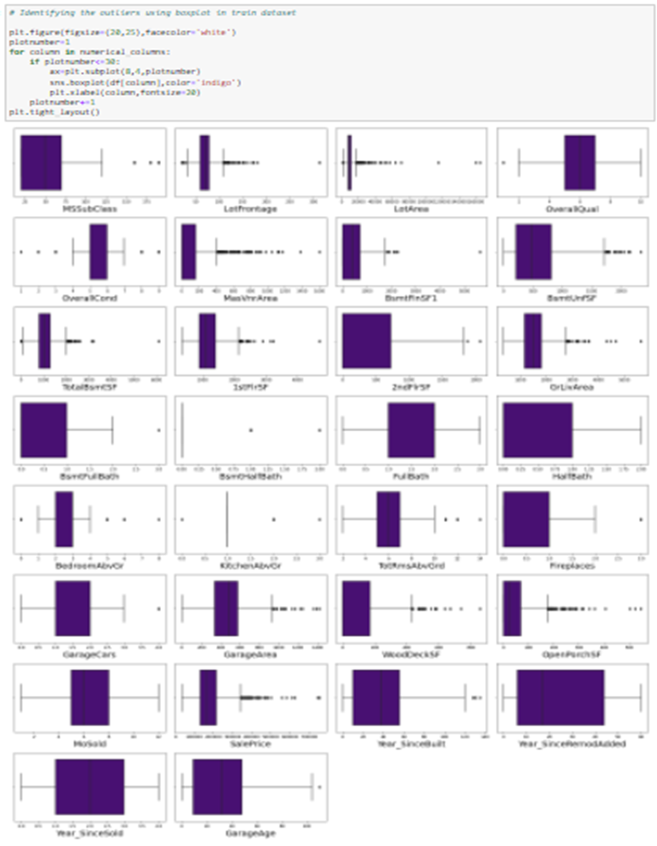
Checking for outliers:

Slide 26
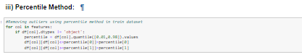
Removing Outliers in train dataset:
I. Z score method
Using Z-score method for train dataset the data loss is more than 10% so let us have a look into IQR method to remove outliers.
II. IQR method
In IQR method the data loss is more than 10% so let us have a look into percentile method to remove outliers.
III. Percentile method
We have successfully removed outliers in train dataset using percentile method.

Slide 27
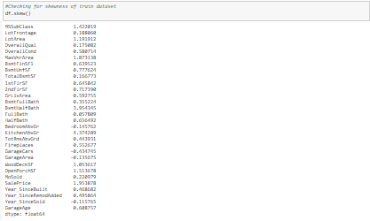
Checking for skewness:
Dropping unnecessary column in train dataset
Removed skewness using yeo-johnson method for train dataset
After removing skewness we have high skewness in BsmtHalfBath .
Let us drop this column from the train dataset
Ordinal Encoding - We have replaced all rating entries with required numbers.
We have encoded all my categorical columns in train and test datasets.

Slide 28
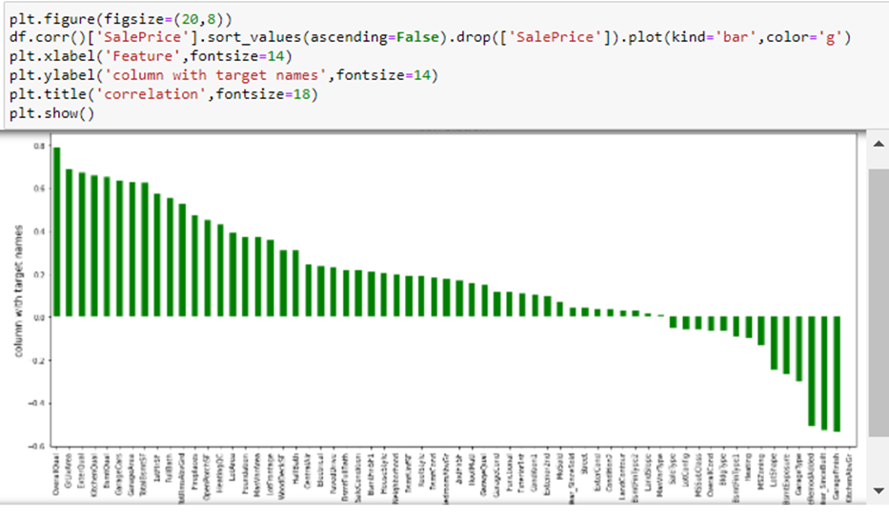
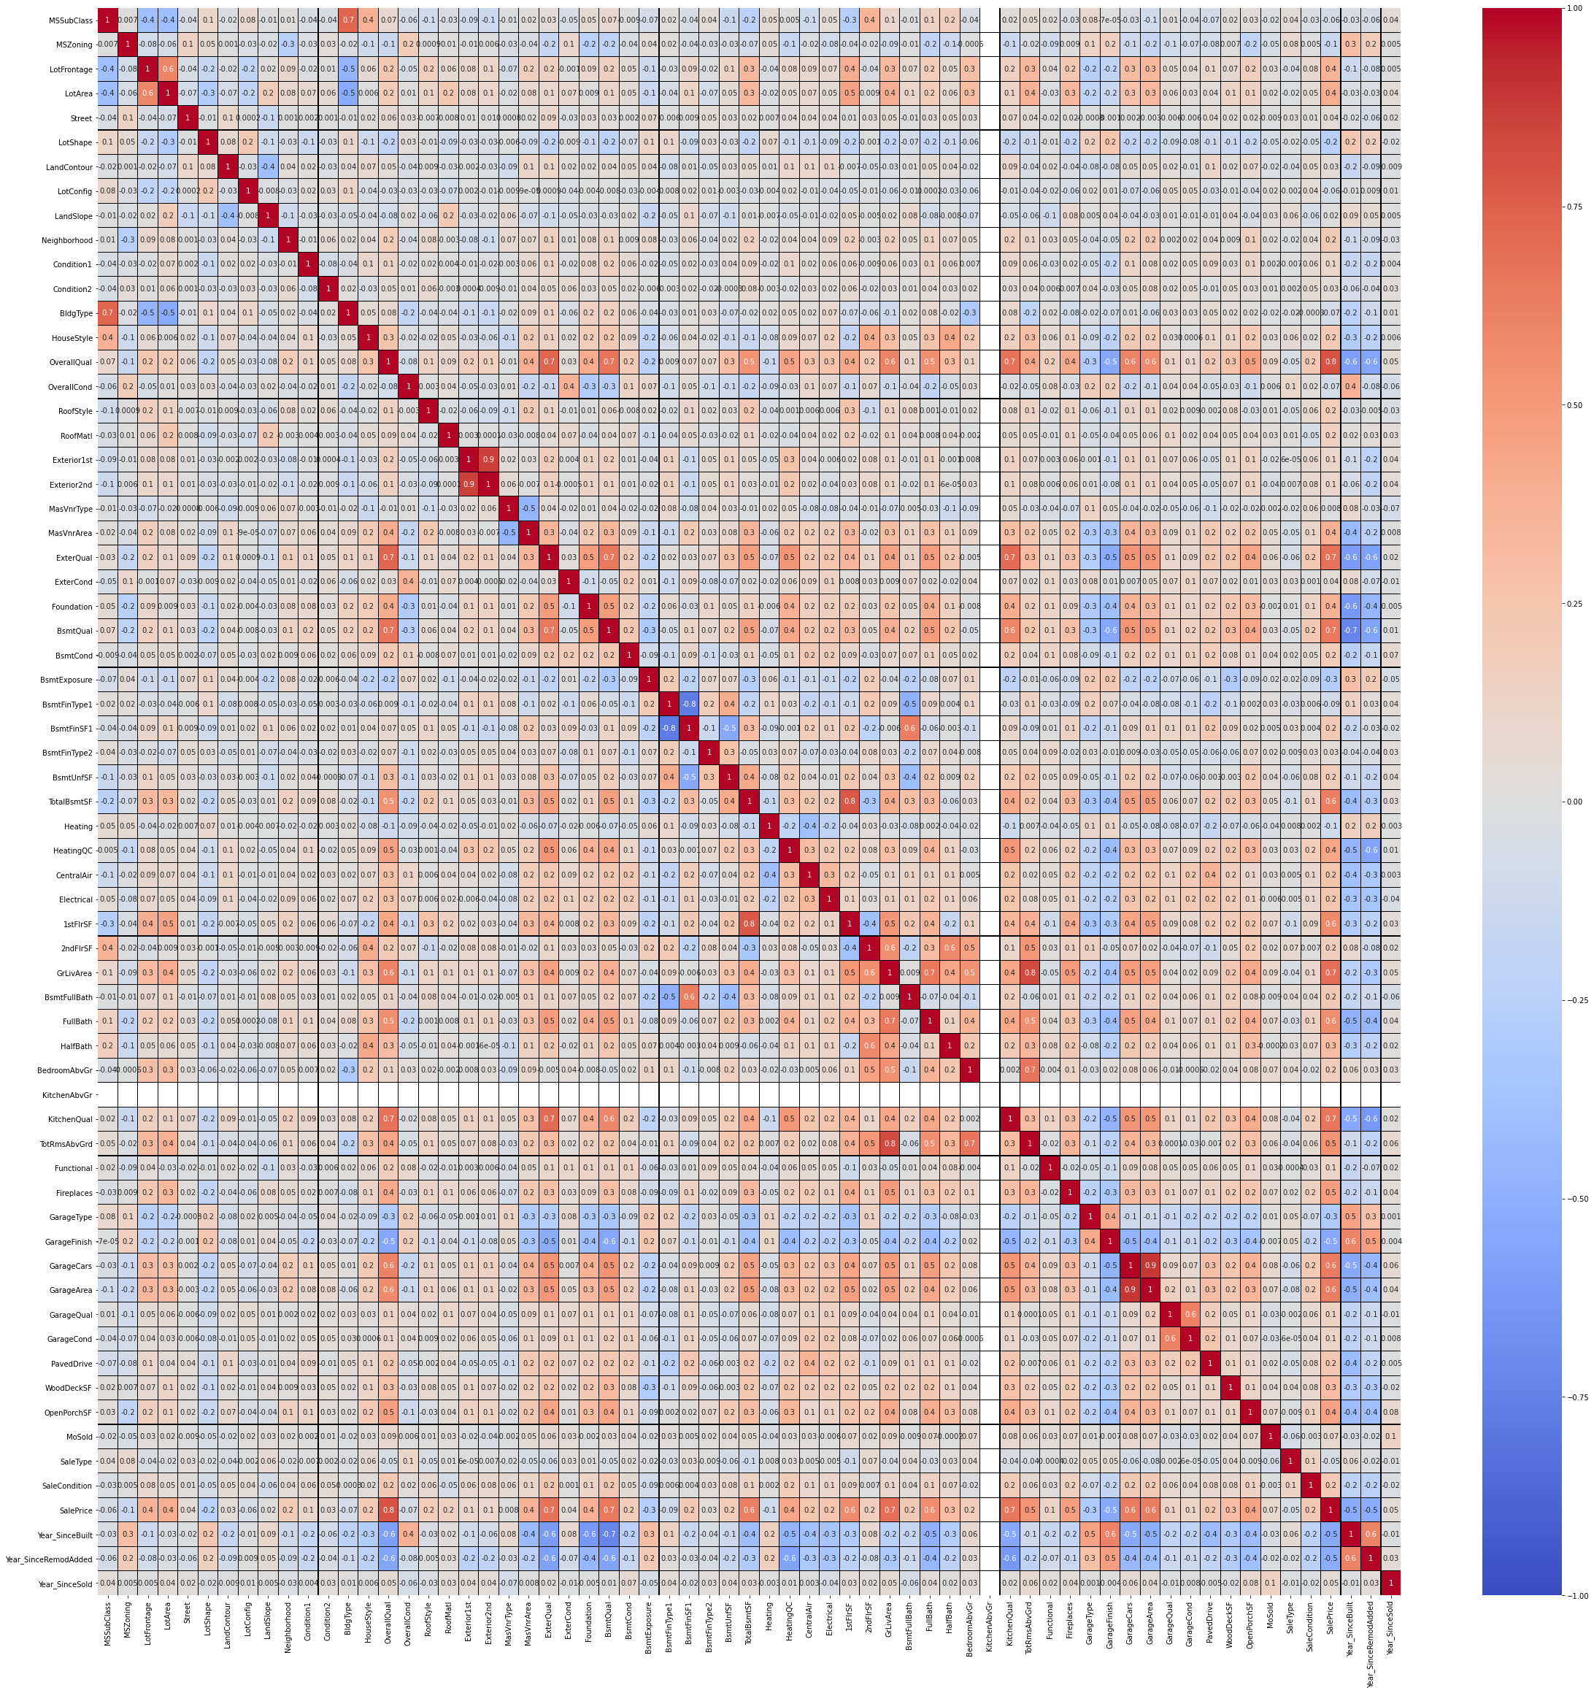
Correlation:

Slide 29
Model/s Development and evaluation
Separating features and label in train dataset:
We have separated the target and independent columns.
Scaling : We have scaled the train data using standard scaler.
Checking for multicollinearity :
We can observe that GrLivArea has high VIF. We can drop this column to reduce the impact of multicollinearity in the dataset
Although there are few columns in the dataset with high VIF than expected, we cannot drop them from the dataset without knowing their importance for the target/ dependent variable, so the multicollinearity issue is solved in train dataset up to some extent.

Slide 30
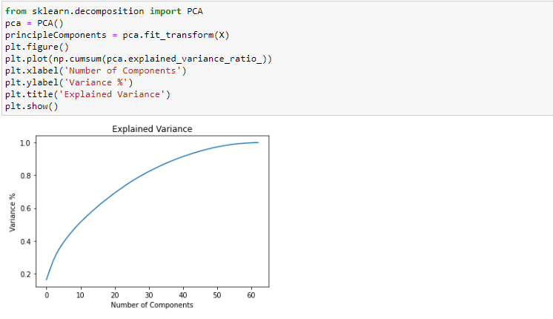
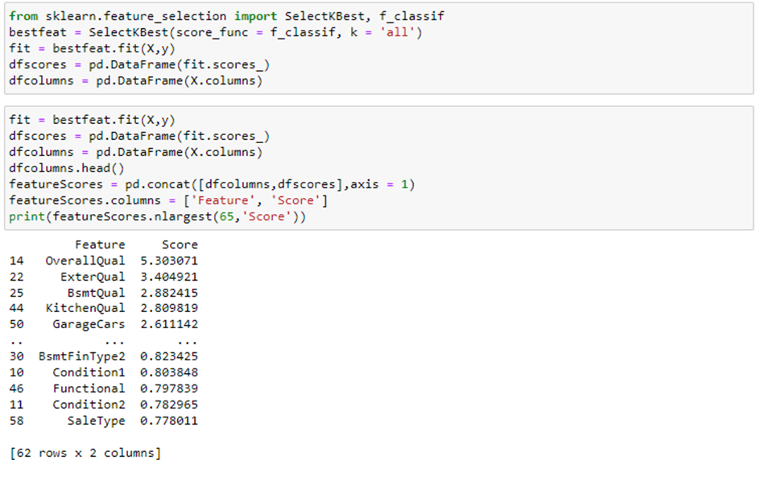
PCA on train dataset
Selecting Kbest Features
We can see the importance of each feature
in the above output
60 components od the dataset explain around 95% variance in output/target
Dropped some least important columns from the dataset

Slide 31
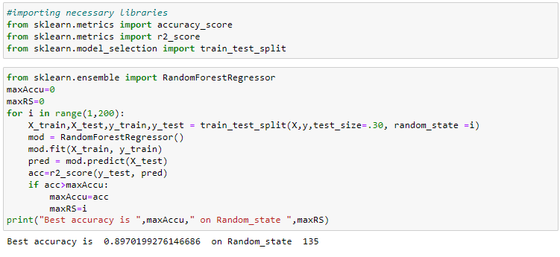
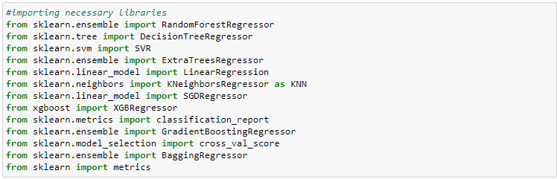
Finding Best Random State and Accuracy:
We got the best accuracy and random state.
Creating train test split.
Regression Algorithms:

Slide 32
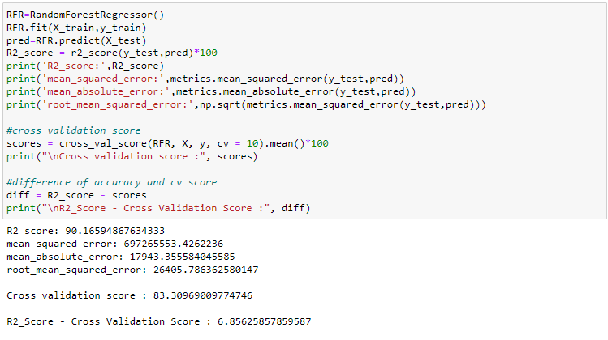
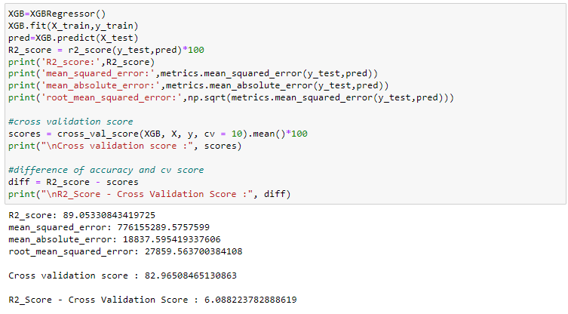
i) RandomForestRegressor:
RandomForestRegressor is giving 90.16% r2_score.
ii) XGBRegressor:
XGBRegressor is giving me 89.05% r2_score.

Slide 33
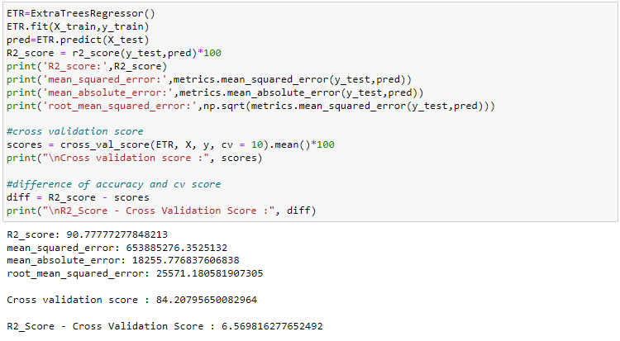
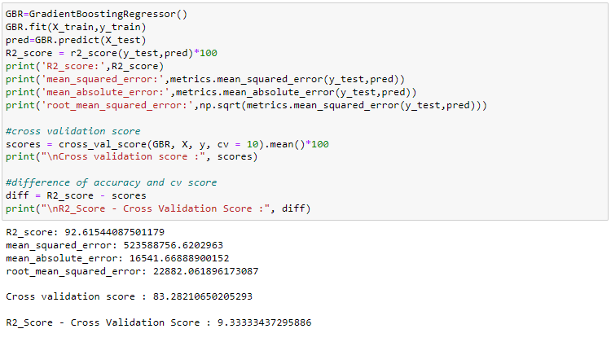
iii) ExtraTreesRegressor:
ExtraTreesRegressor is giving me 90.77% r2_score.
iv) GradientBoostingRegressor:
GradientBoostingRegressor is giving me 92.61% r2_score.

Slide 34
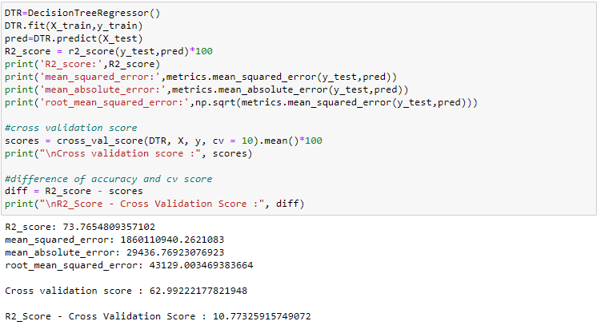
v) DecisionTreeRegressor:
DecisionTreeRegressor is giving me 73.76% r2_score.
After observing the difference of model accuracy and cross validation score we
can see RandomForestRegressor as the best model.

Slide 35
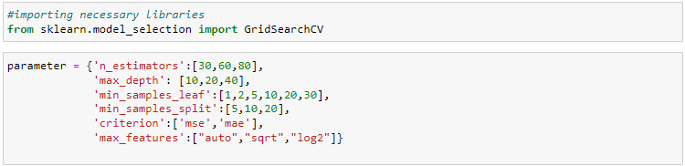
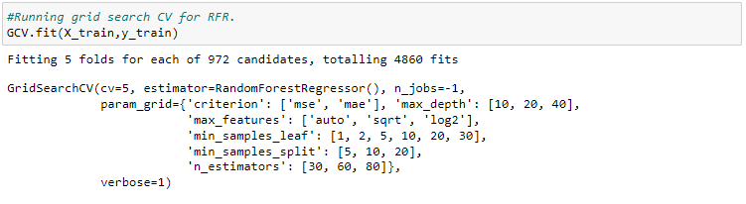
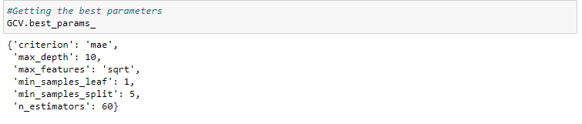
Hyper parameter tuning
Giving RFR parameters and Running grid search CV for RFR
Tuning the model using GCV.
Getting the best parameters

Slide 36
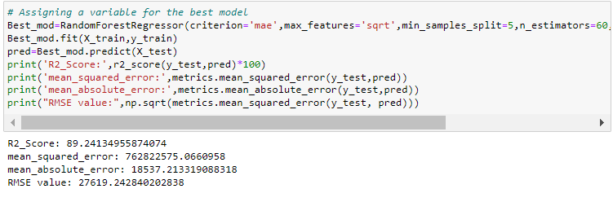
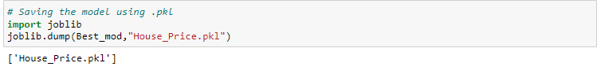
Assigning a variable for the best model
This is the model r2_score after tuning. We have 89.24% as r2_score which is good to proceed with.
Saving the model:
We have saved the model as House_Price.Using .pkl

Slide 37
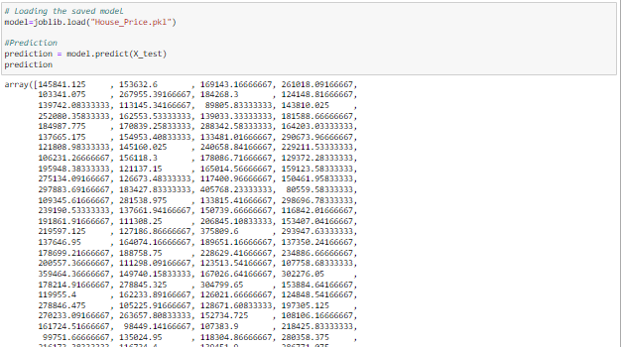
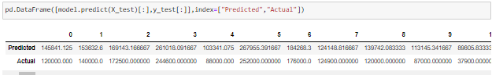
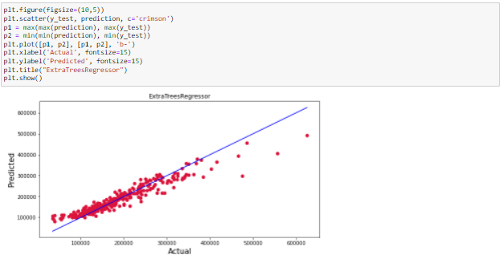
Predicting House Price for test dataset using Saved model of train dataset
Creating a data frame of actual vs predicted values
Above are the predicted values and the actual values. They look similar.
Visualizing the actual vs predicted values
Blue line is the actual line and red dots are the predicted values.
They are similar apart from few exceptions

Slide 38
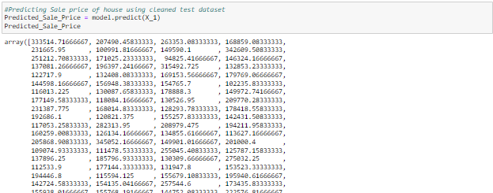
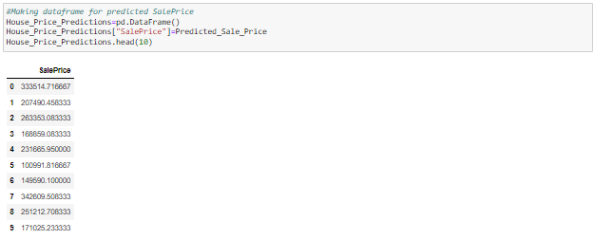
Predicting Sale price of house using cleaned test dataset
Making dataframe for predicted SalePrice
Saving the predictions to csv
We have saved the predicted values as csv file.

Slide 39
Key Findings and Conclusions of the Study
Based on the in-depth analysis of the Housing Project, The Exploratory analysis of the datasets, and the analysis of the Outputs of the models the following observations are made:
● Structural attributes of the house Structural attributes of the house like lot size, lot shape, quality and condition of the house, garage capacity, rooms, Lot frontage, number of bedrooms, bathrooms, overall finishing of the house etc play a big role in influencing the house price.
● Neighborhood qualities can be included in deciding house price.
● Various plots like Barplots, stripplots and distplots helped in visualising the Feature-label relationships which corroborated the importance of structural and locational attributes for estimating Sale Prices.
● Due to the Training dataset being very small, the outliers had to be retained for proper training of the models.
● Therefore, Random Forest Regressor, being robust to outliers and being indifferent to nonlinear features, performed well despite having to work on small dataset.

Slide 40
Learning Outcomes of the Study in respect of Data Science
I found that the dataset was quite interesting to handle as it contains all types of data in it. Improvement in computing technology has made it possible to examine social information that cannot previously be captured, processed and analyzed. New analytical techniques of machine learning can be used in property research. The power of visualization has helped us in understanding the data by graphical representation it has made me to understand what data is trying to say. Data cleaning is one of the most important steps to remove missing value and to replace null value and zero values with their respective mean, median or mode. This study is an exploratory attempt to use five machine learning algorithms in estimating housing prices, and then compare their results.
To conclude, the application of machine learning in property research is still at an early stage. We hope this study has moved a small step ahead in providing some methodological and empirical contributions to property appraisal, and presenting an alternative approach to the valuation of housing prices. Future direction of research may consider incorporating additional property transaction data from a larger geographical location with more features, or analyzing other property types beyond housing development.

Slide 41
Limitations of this work and Scope for Future Work
While features that focus on structural and locational attributes of housing properties are crucial for estimating the Sale Price of Housing properties, they aren’t the only factors that influence the value in the housing market. Data on Demographics (Age, Income, Regional preferences of buyers, purpose of buying a property) is very important for understanding the Housing market. Interest Rates too impact the price and demand of houses. Economic cycles also influence Real Estate prices. Government Policies, Regulations, Legalizations are also important factors that may influence the sales of houses. The availability of data on above features would help build a predictive model that would more accurately understand the relationship between the features and target variable and yield more accurate predictions.
To conclude, the application of machine learning in property research is still at an early stage. We hope this study can provide some methodological improvements and contributions to property calculation and presenting an alternative to the valuation of housing prices. Future direction of research may consider incorporating additional property transaction data including more features.

Slide 42


